Slide 1




Adaptive Lossless Image Compression Using Huffman Encoding

Slide 2


Introduction
Role played by data compression in the field of image storage and communication context.
The uniqueness of this compression is that it retains the data input without reduction in quality.
Huffman Encoding is one of the simplest example of algorithms that comes under lossless compression method.
Objective: Adaptive lossless encoding and decoding for images should be applied.
Notes:
In the introduction of the article, the authors reveal the increased demand for data compression and, particularly, image compression. ContentType techniques such as Huffman Encoding allow no data to be removed in compression; these make them crucial for handling large image databases (Hameed, Ibrahim, Manap, & Mohammed, 2020).

Slide 3
Problem Statement and Objectives
Challenge: A fast picture archival method that supports large digital images without degrading picture quality.
Traditional methods are of low quality, or reduced in size.
Contrary to other loss data compression techniques Huffman Encoding offer a loss less approach.
Objectives: Check/compress data for optimal level; measure time of encoding/decoding and check efficiency of decompression as well.
Notes:
The problem is to compress big digital images without losing their quality. Specific goals encompass the development of Huffman based algorithm, the computation of compression ratios, as well as making sure that the decompressed digital image is an exact replica of the original image thereby making it possible to analyze images in a loss less environment (Hameed, Ibrahim, Manap, & Mohammed, 2020).

Slide 4
Huffman Encoding Overview
One of it encodes the symbols with binary code according to the frequency with which they occur.
Fewer symbols getting shorter codes to enable type quickly, more getting longer codes to enable type slowly.
From the frequency distribution a structure of binary tree is constructed.
Representatives of the PHP scripting language embed generates a compressed bitstream for the image.
Notes:
Huffman Encoding provides smaller codes to more dominant pixel values so as to achieve the best of the compression. It entails frequency analysis of the domain and range, construction of binary tree as well as code generation. Our Adaptive Huffman Encoding alters with the actual pixel frequencies in real-time (Hidayat, Zakaria, & Pee, 2022).

Slide 5
Adaptive Huffman Encoding Process
Modifies the Huffman tree in the course of the encoding process.
Able to switch between different symbol frequencies when image data is being analyzed.
Aids in raising the degree of compression required by images with mixed subject matter.
Is more flexible and affords better performance as compared to the traditional Huffman Encoding.
Notes:
During implementation, the Python libraries NumPy and Pillow can be used for the computation related to the images. This dataset comprises of CIFAR-500 grey scale images. Huffman trees are build, the pixel data get encoded, and original bitstreams are produced for storage with lower size (Hidayat, Zakaria, & Pee, 2022).

Slide 6
Implementation and Tools
But for the implementation of neural networks, the images should be in NumPy arrays, and therefore, we should load grayscale images only and convert them into NumPy arrays.
Determine the pixel frequency and create Huffman tree using priority queues with a collection of leaf nodes.
Substitute pixel value with Huffman codes of same digit.
For decoding, keep the compressed bitstream and tree structure in the ordinary Stbin storage array.
Notes:
Compression consists in constructing the Huffman tree and emitting two-stroke byte streams. The decode read out steps decompress the Huffman stream and reconstruct the lost pixel data by following the Huffman tree, then reforms the raw image data in the form as it was without any loss of data (Liu, Wang, & Gao, 2022).

Slide 7
Encoding and Decoding Process
Take the Huffman tree and the compressed bitstream.
Cross the tree to retrieve values for pixel based on binary formatted strings.
Decoding of pixel data into image pixels depends on a specific reconstruction given regular resolution.
Privilege accuracy of the decompressed picture over that of the original image.
Notes:
Adaptive Huffman Encoding changes the tree while image processing is going on; it improves the images with different pattern by compaction. This method is most relevant to images with more variability in the distribution of pixels (Liu, Wang, & Gao, 2022).

Slide 8
Compression Ratio Analysis
Compression Ratio: Maintained a ration of about 1.16: 1 in this project.
Impact of Image Content: Uniform pictures can be compressed to a greater extent than a complicated picture.
Encoding Time: Depending on the image’s complexity and the distribution of the number of pixels, it is usually the process takes more time than decoding.
Notes:
The Huffman algorithm achieved a 1.16:1 compression ratio. The results revealed that images with uniform regions were compressed more efficiently. The encoding was slower, since constructing a search tree is computationally expensive, while decoding was faster, and only involved tree traversal (Sharma & Batra, 2018).

Slide 9
Encoding and Decoding Time Performance
Graph of the different sizes of the original image and the compressed image.
Compression ratios of most compressed images were less than 0. 5 times the size of the original images.
The flexibility of the algorithm is illustrated if we analyze compression ratios fluctuation.
A general trend seen from the graph is that, there is a trade-off between the image complexity and the compression ratio.
Notes:
Self-scaled images have been compared to the original ones alongside histograms presenting the average decrease in the file size by 25 – 50%. These visualizations show that scalar functions of image complexities can efficiently be learned by algorithms (Sharma & Batra, 2018).

Slide 10
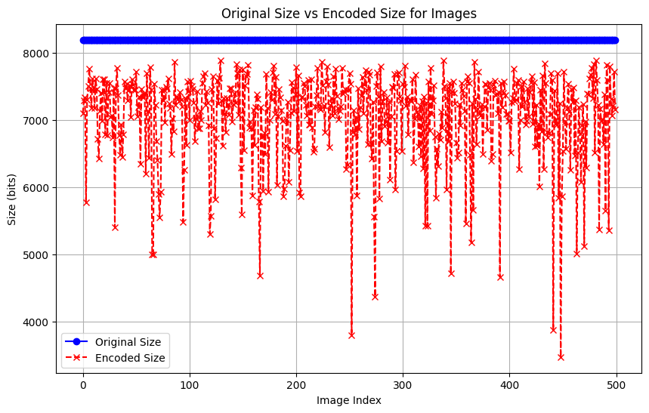
Decompression Accuracy and Graphical Results
The Huffman Encoding algorithm has been found to efficiently compress grayscale images with no loss of data.
The higher compression ratios depend on bottom pixels uniformity and image complexity.
While the process of encoding is a very workload process, the decoding is very swift.
Suitable for applications that need frequent decompression in terms of relevancy.
Notes:
After decompressing and comparing the images pixel by pixel it was established that lossless compression was indeed achieved through the algorithm. This guarantees the quality of image data at the time of decomposition (AbdelWahab, Hussein, Hamed, Kelash, & Khalaf, 2021).

Slide 11
Conclusion and Future Work
Learn why media encoding often takes longer than expected, and how parallel processing and GPU acceleration can cut the time down to size.
Research other lossless algorithms which includes Arithmetic Coding and LZW.
Design an easy to use graphical interface for non computer literate people.
Generalize the fixed length algorithm to process color images, and to larger datasets.
Notes:
The project delivered the required adaptive Huffman encoding for lossless image compression. Someday’s research could be directed on optimizing the algorithm through multiprocessor annotation, other methods such as Arithmetic Coding or designing more inviting graphical user interface for maximum utility (AbdelWahab, Hussein, Hamed, Kelash, & Khalaf, 2021).

Slide 12


References
AbdelWahab, O. F., Hussein, A. I., Hamed, H. F. A., Kelash, H. M., & Khalaf, A. A. M. (2021). Efficient Combination of RSA Cryptography, Lossy, and Lossless Compression Steganography Techniques to Hide Data. Procedia Computer Science, 182, 5–12. https://doi.org/10.1016/j.procs.2021.02.002
Hameed, M. E., Ibrahim, M. M., Manap, N. A., & Mohammed, A. A. (2020). A lossless compression and encryption mechanism for remote monitoring of ECG data using Huffman coding and CBC-AES. Future Generation Computer Systems, 111, 829–840. https://doi.org/10.1016/j.future.2019.10.010
Hidayat, T., Zakaria, M. H., & Pee, A. N. C. (2022). Increasing the Huffman generation code algorithm to equalize compression ratio and time in lossless 16-bit data archiving. Multimedia Tools and Applications. https://doi.org/10.1007/s11042-022-14130-1
Liu, M., Wang, K., & Gao, T. (2022). High-capacity reversible data hiding in encrypted images based on adaptive arithmetic coding and static Huffman coding. Cluster Computing, 26(6), 3627–3645. https://doi.org/10.1007/s10586-022-03748-3
Sharma, N., & Batra, U. (2018). Performance analysis of compression algorithms for information security: A Review. ICST Transactions on Scalable Information Systems, 0(0), 163503. https://doi.org/10.4108/eai.13-7-2018.163503

